Slide 1
Weekly meeting
1 18 2024
Ty Bottorff

Slide 2
Outline
Patient bias plots for colitis dataset cell type abundance differences by irAE group
Airline plots for cell types more abundant in colitis irAE tissue
Convergence histograms
Non-cumulative feature heatmaps

Slide 3
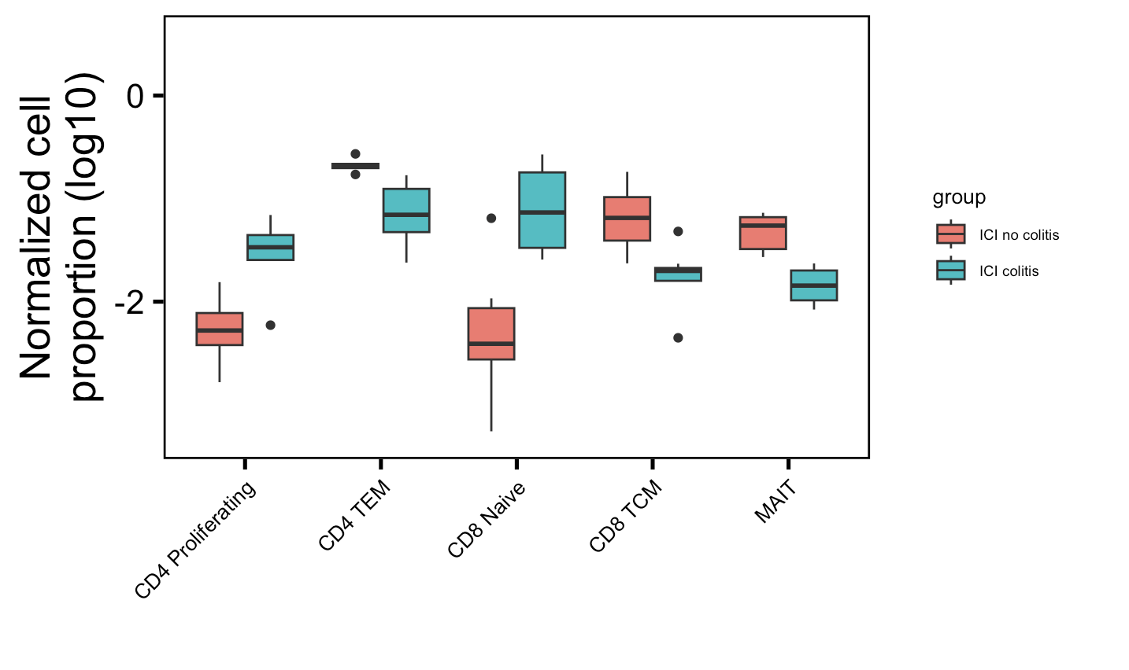
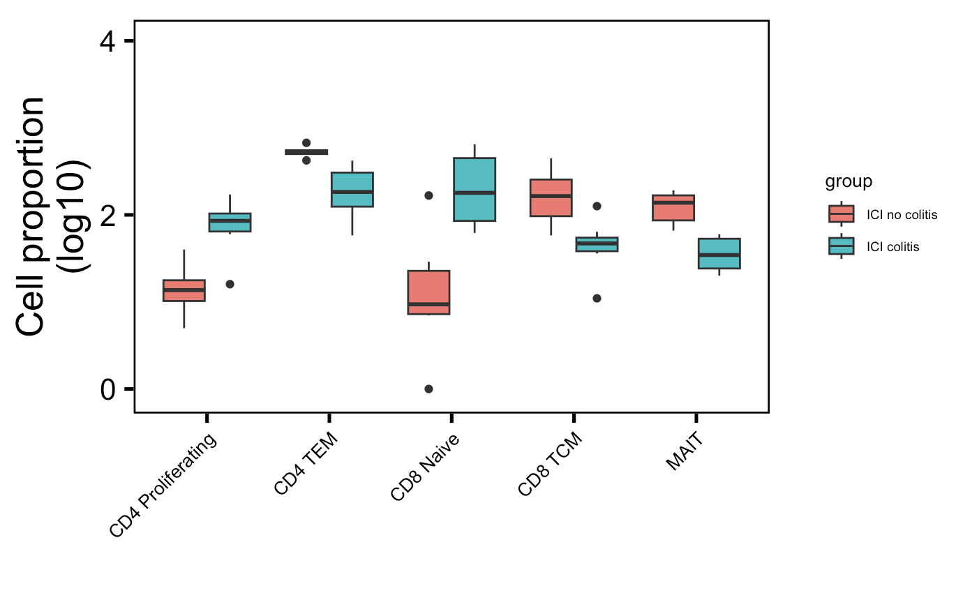
Review of cell type abundance differences in colitis dataset before showing patient bias plots
Normalized by clonotype depth
Downsampled
*
**
*
*
**
*
**
*
*
**
Wilcox rank sum test: **; padj <1e-2, *; padj <0.05
Notes:
There’s only 1 patient in myocarditis dataset that had colitis and had scRNAseq data… not worth looking into anything with n = 1 I don’t think
# padj normalized by clonotype depth
# CD4 Proliferating: 0.01
# CD4 TEM: 0.004
# CD8 Naive: 0.01
# CD8 TCM: 0.01
# MAITs: 0.004
# padj values downsampled
# CD4 Proliferating: 0.01
# CD4 TEM: 0.004
# CD8 Naive: 0.02
# CD8 TCM: 0.01
# MAITs: 0.004

Slide 4
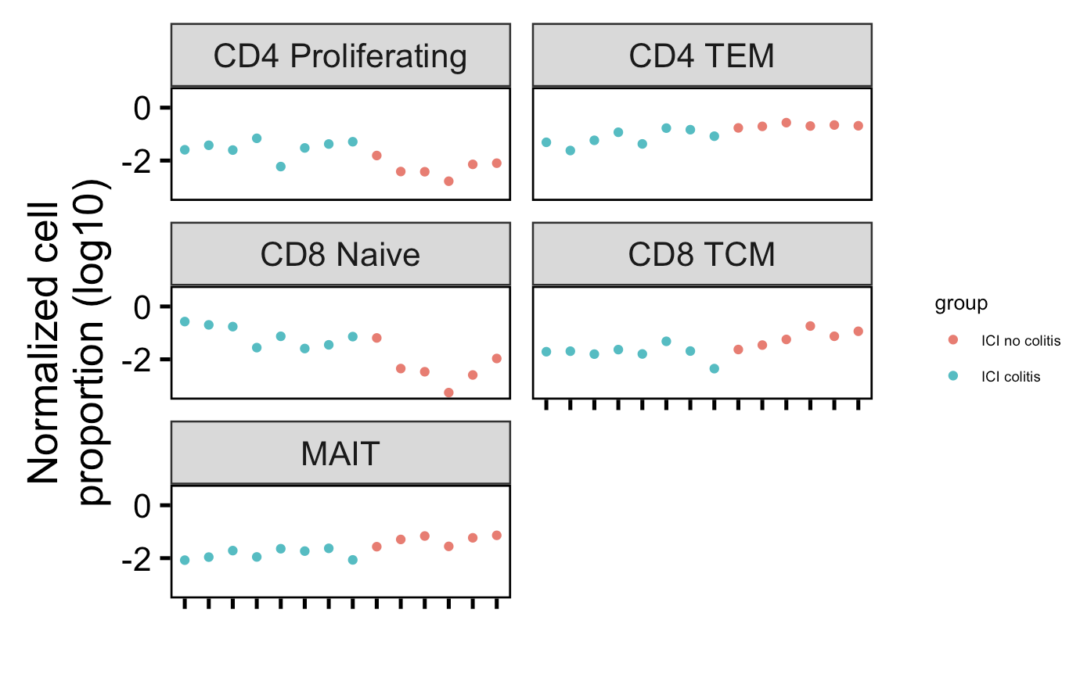
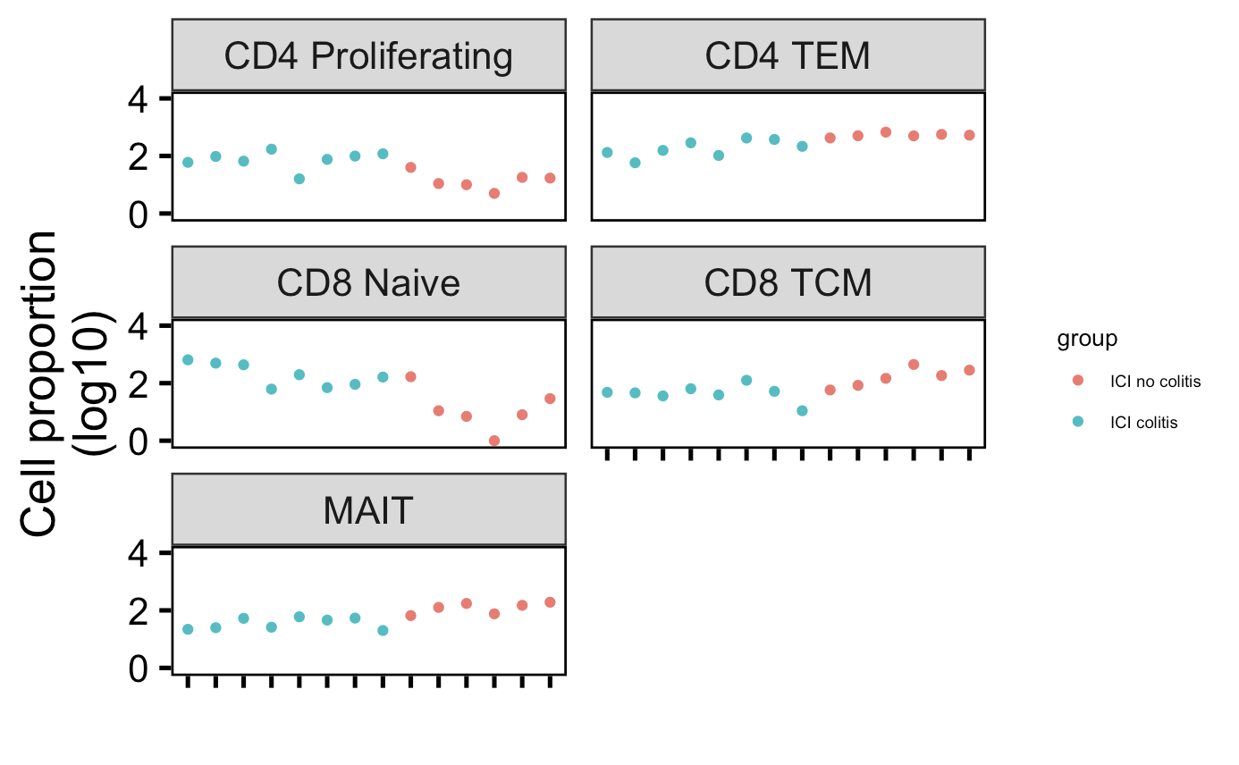
Cell type abundance differences in colitis dataset do not seem to be driven by single/few patients
Normalized by clonotype depth
Downsampled
Notes:
There’s only 1 patient in myocarditis dataset that had colitis and had scRNAseq data… not worth looking into anything with n = 1 I don’t think
# padj normalized by clonotype depth
# CD4 Proliferating: 0.01
# CD4 TEM: 0.004
# CD8 Naive: 0.01
# CD8 TCM: 0.01
# MAITs: 0.004
# padj values downsampled
# CD4 Proliferating: 0.01
# CD4 TEM: 0.004
# CD8 Naive: 0.02
# CD8 TCM: 0.01
# MAITs: 0.004

Slide 5
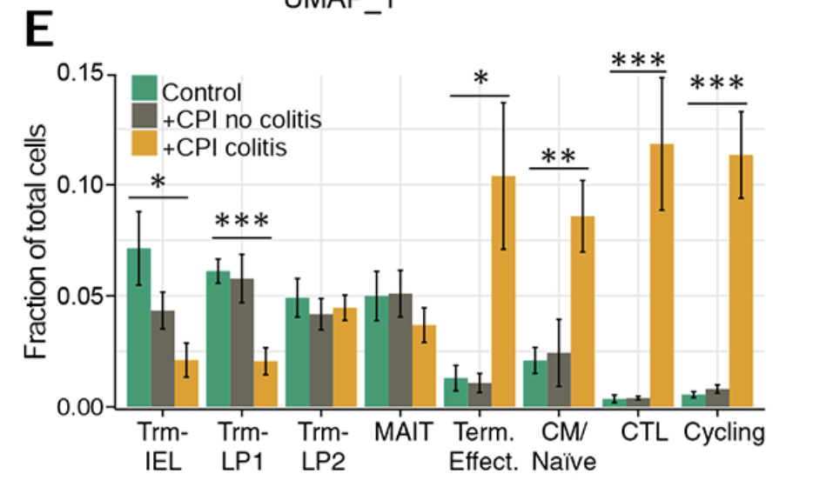
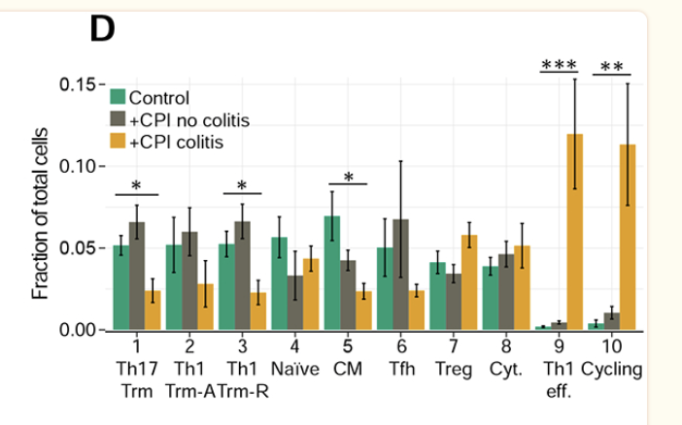
Colitis dataset: different cell types obscure conclusion comparisons between my mining and their results
CD4s
CD8s
Fewer CD4 TCM in colitis irAE group which I didn’t see (I saw fewer CD4 TEM)
Group CD8 TCM/Naïve that I see having opposite abundance trends…
fewer MAITs in irAE group does recapitulate though
Notes:
My impression is that their cell typing was ~manual based on marker expression

Slide 6
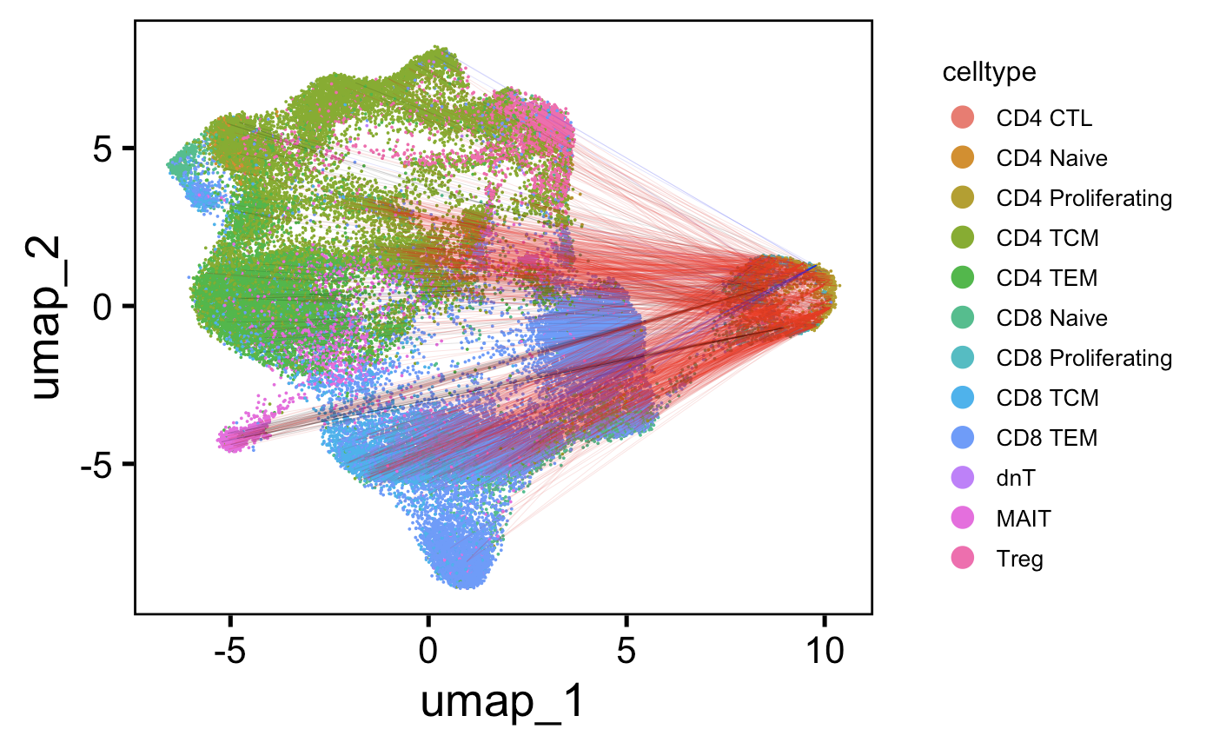
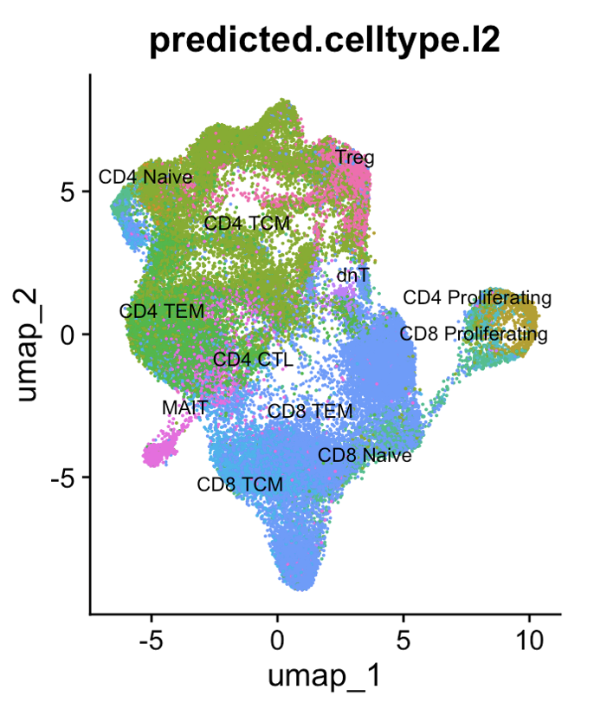
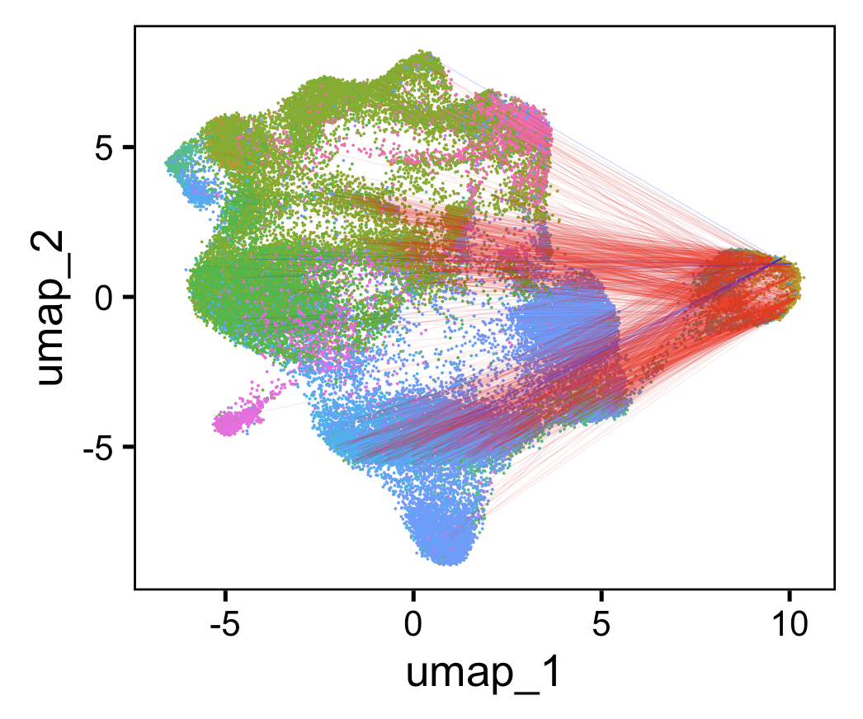
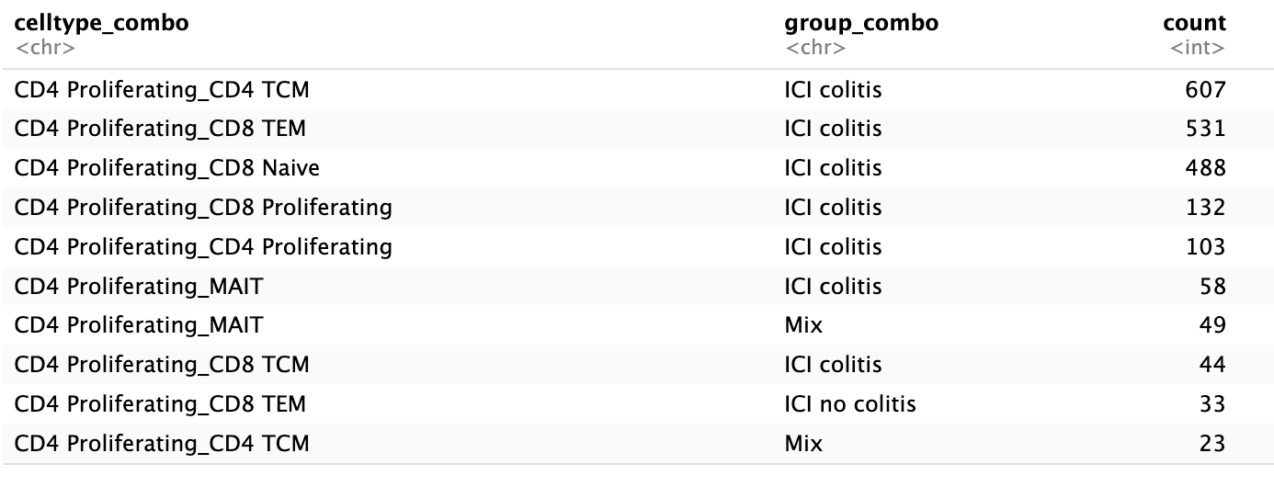
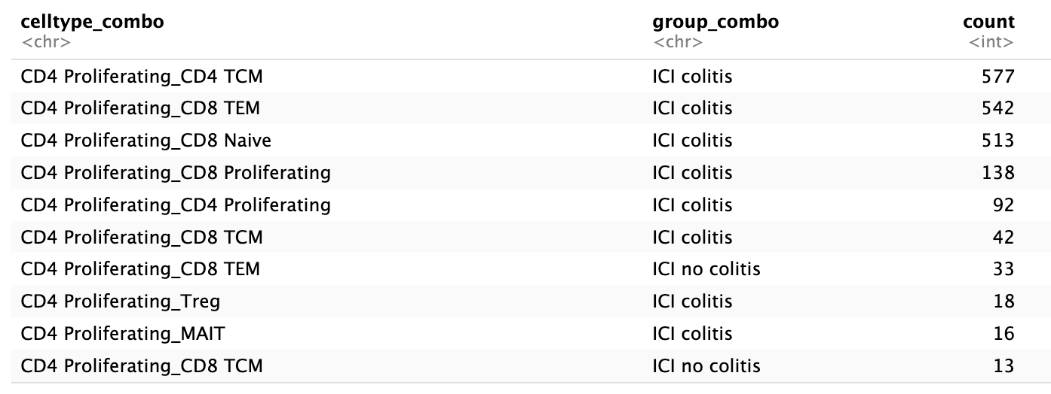
In colitis dataset, junctions of CD4 proliferating cells mostly shared with CD4 TCM, CD8 TEM, CD8 Naïve cells
Line color:
Colitis irAE
No colitis irAE
Mix
TRA
TRB
Chose 1500 random (ICI) linkages
to plot (memory limit)
Notes:
Linkages mostly intra-ICI colitis because this cell type more abundant in that group

Slide 7
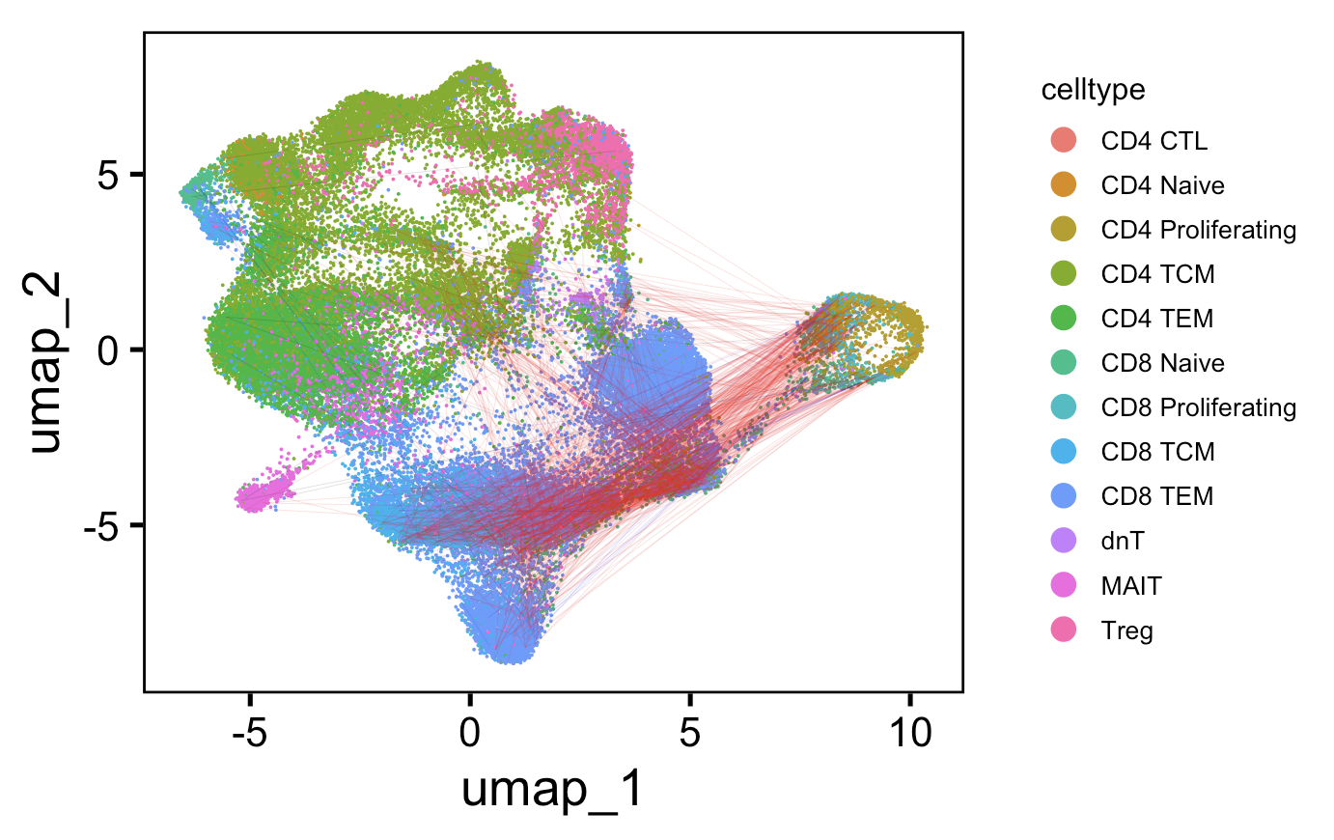
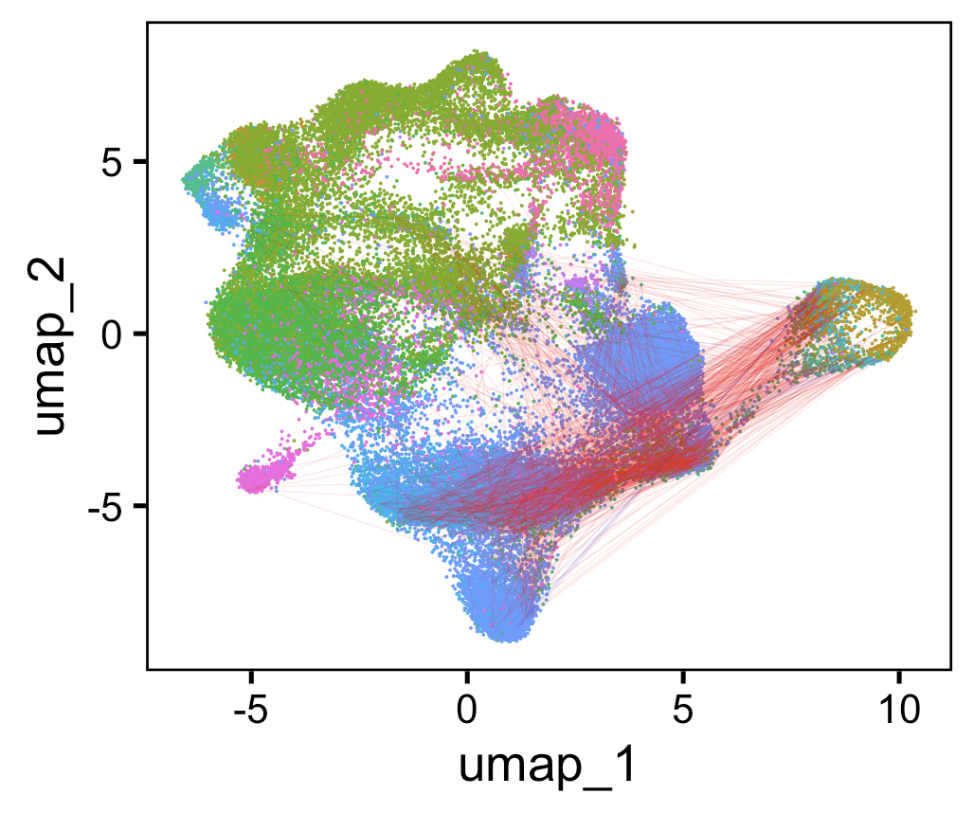
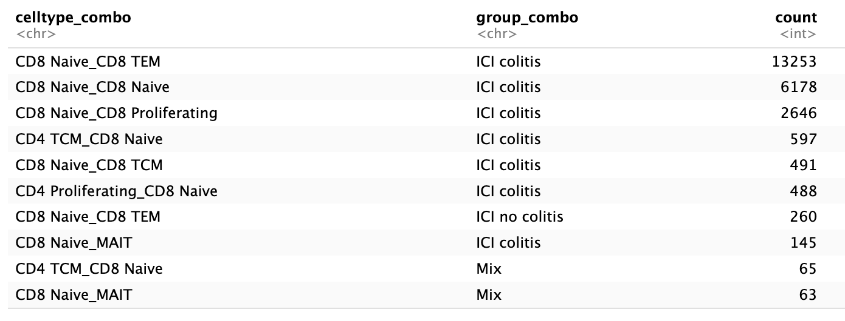
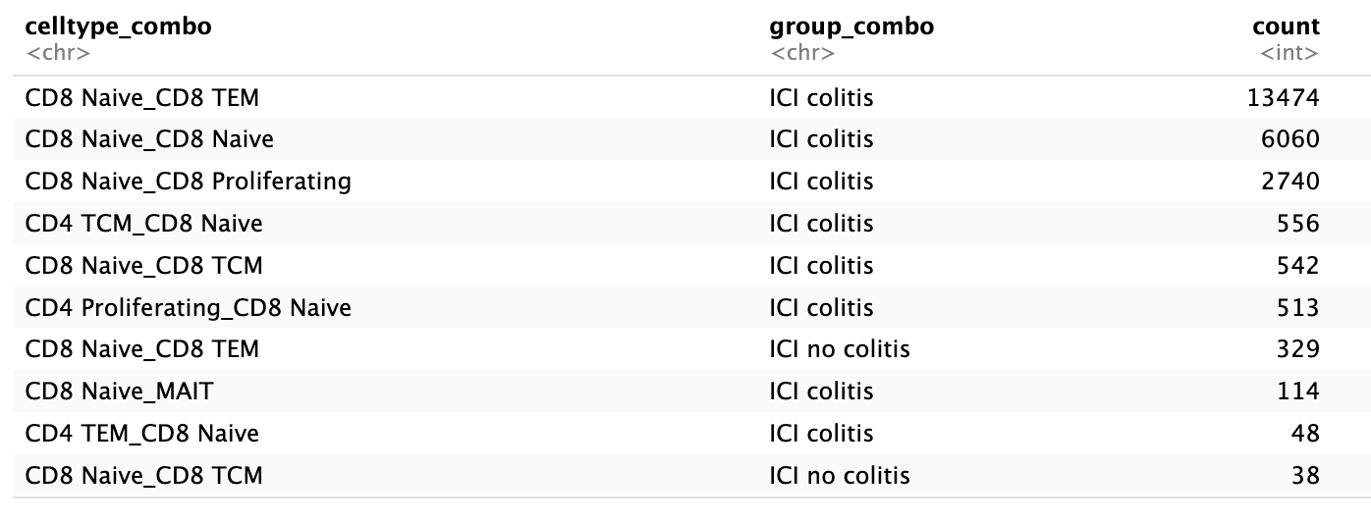
In colitis dataset, junctions of CD8 naive cells mostly shared with CD8 TEMs, themselves, CD8 proliferating cells
Line color:
Colitis irAE
No colitis irAE
Mix
TRA
TRB
Chose 1500 random (ICI) linkages
to plot (memory limit)
Notes:
Linkages mostly intra-ICI colitis because this cell type more abundant in that group

Slide 8
Convergence methods
Colitis dataset: filter out no ICI group
Group by cdr3 AA sequence
Count n_distinct cdr3 NT seqs per CDR3 AA
Ungroup
Group by CDR3 AA and irAE group (to deal with cases where CDR3 in both groups)
Slice(1)
Perform wilcox test on distributions of CDR3 NT seqs/CDR3 AA for 2 irAE groups
To plot, normalize each irAE group by sum of counts, transform y-axis
Notes:
don’t want to group by patient instead for step 5 because then double counting CDR3s?

Slide 9
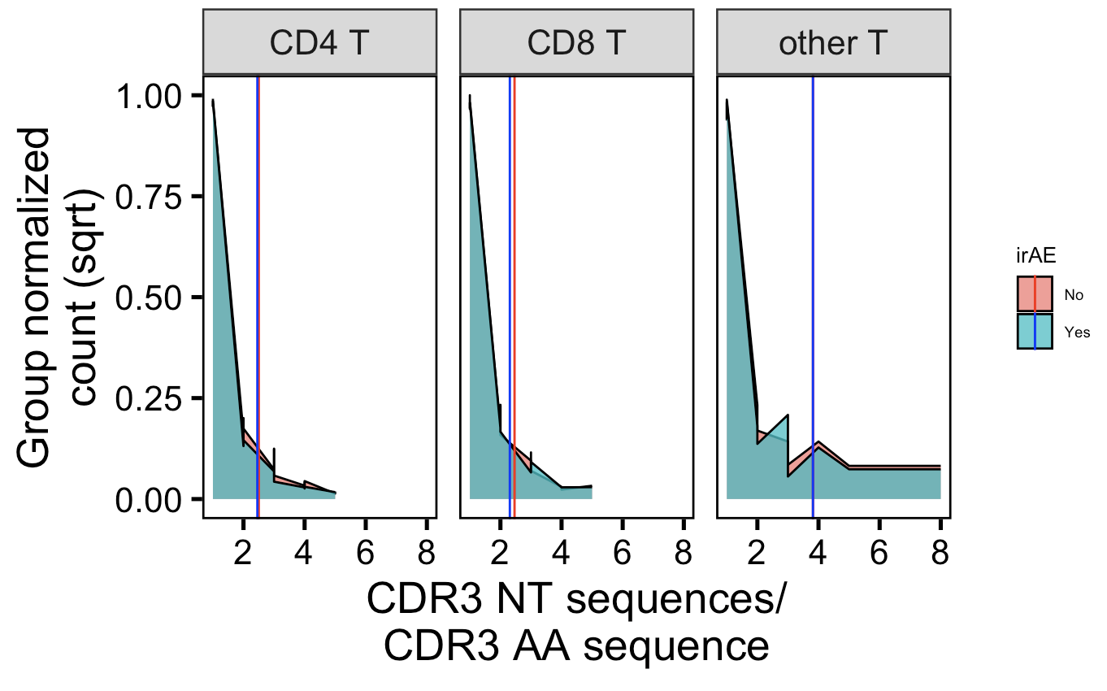
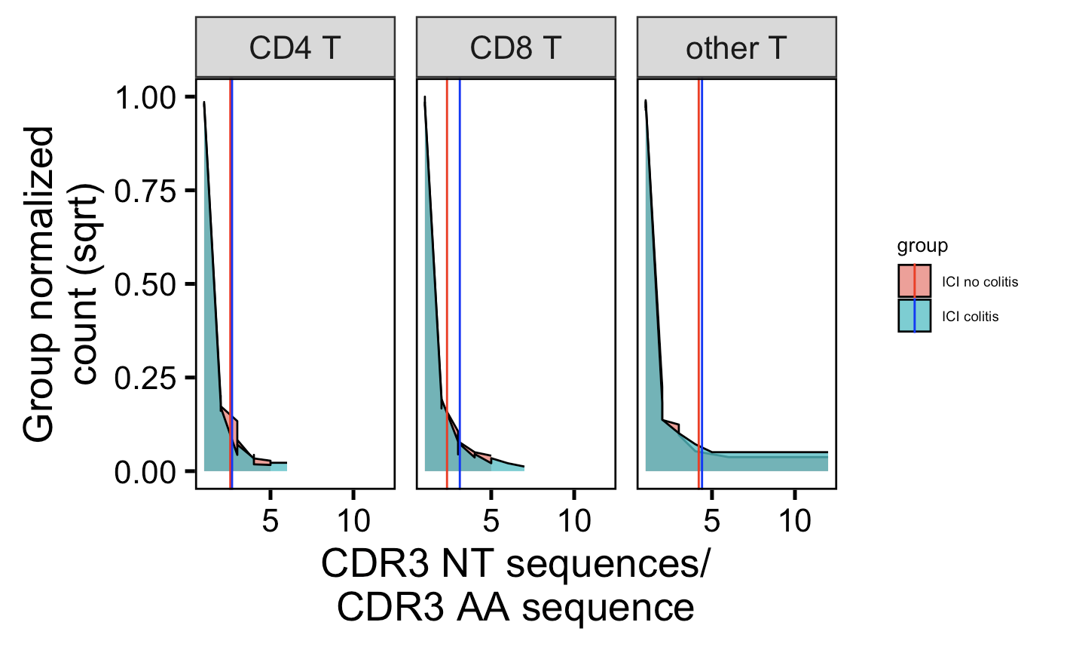
Convergence higher in no irAE group in myocarditis dataset CD4 Ts, lower in no irAE group in colitis dataset CD4 Ts…
Myocarditis dataset
Colitis dataset
**
****
vertical lines are means
caveat: including both intrapatient & interpatient convergence
Wilcox rank sum test: ****; padj < 1e-4, **; padj <1e-2, *; padj <0.05
Notes:
Myo # CD4 T: 0.00062 (padj)
Colitis # CD4 T: 2e-6 (padj)
Ask Peter if this is what he envisioned for me doing for this data? Offer to perform on his data

Slide 10
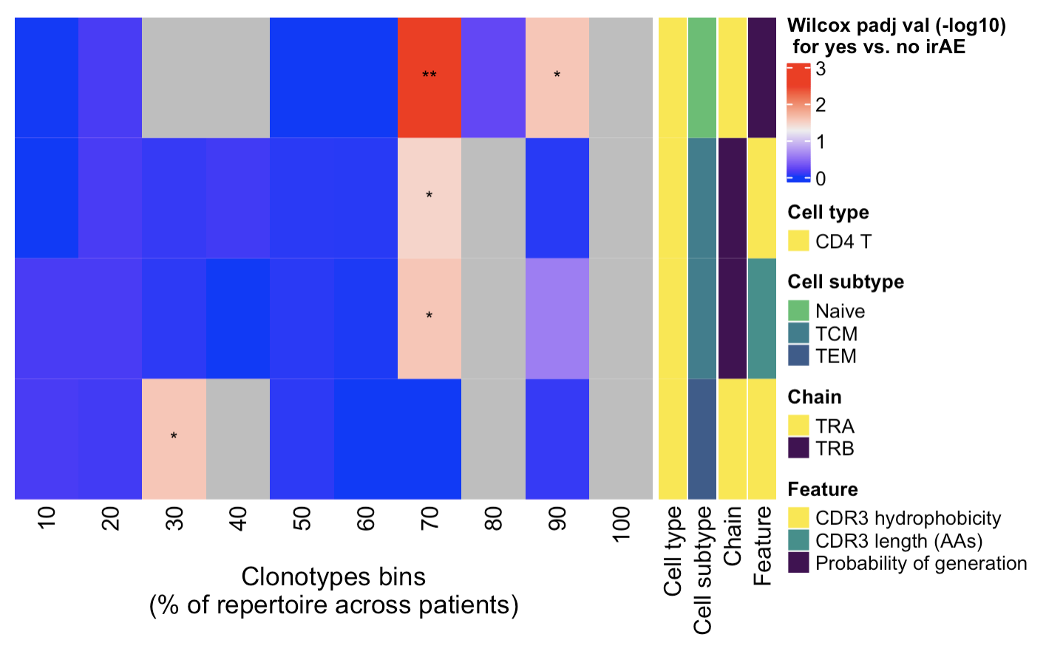
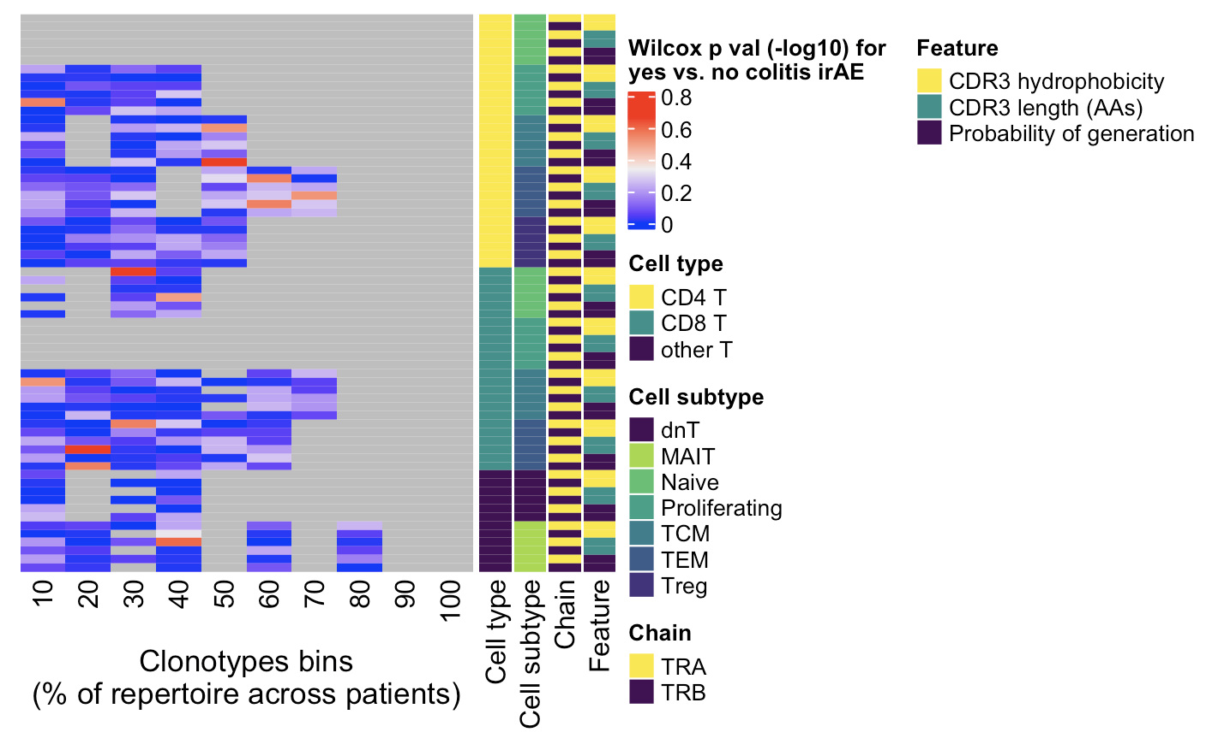
Given ability of rare clonotypes to drive disease, also investigated non-cumulative clonotype heatmaps
Myocarditis dataset
Colitis dataset
adj
← Increasing clonotype abundance
← Increasing clonotype abundance
**, padj <1e-2; *; padj <0.05
Notes:
Clonotypes here for both heatmaps ordered by counts normalized by clonotype depth
# CD4 Naive TRB hydrophobicity 70, 90%
# CD4 TCM TRB hycrophobicity 70%
# CD4 TCM TRB CDR3 length 70%
# CD4 TEM TRA hydrophobicity 30%

Slide 11
Conclusions
Cell type abundance differences in colitis dataset do not seem to be driven by single/few patients but do not compare well to their results
In colitis dataset, junctions of…
CD4 proliferating cells mostly shared with CD4 TCM, CD8 TEM, CD8 Naïve cells
CD8 naive cells mostly shared with CD8 TEMs, themselves, CD8 proliferating cells
2 datasets have opposite conclusions for CD4 T convergence differences by irAE group
No difference in convergence/publicity between irAE groups for cell types more abundant in colitis irAE tissue (data not shown)
In myocarditis dataset, uncover some feature differences between irAE groups (caveat: only in myocarditis dataset and not recapitulated in downsampled method, so perhaps driven by single/few patients)
rare CD4 Naïve cells’ TRB hydrophobicity
rare CD4 TCMs’ TRB hydrophobicity: 70%
rare CD4 TCMs’ TRB CDR3 length: 70%
highly expanded CD4 TEMs’ TRA hydrophobicity: 30%

Slide 12
Next steps
Reconsider how I assign cell types? Interested in cell types Seurat reference mapping hasn’t generated for me
Trm (perhaps because reference is PBMCs?)
Temra
Exclude intrapatient convergence from convergence histograms
Not sure yet exactly how to do this (i.e. each patient can only contribute 1 to total CDR3 NTs / CDR3 AA count?)
Draft SI slides before next weekly meeting
Recapitulate Erin’s figures (ATACseq analysis)

Slide 13
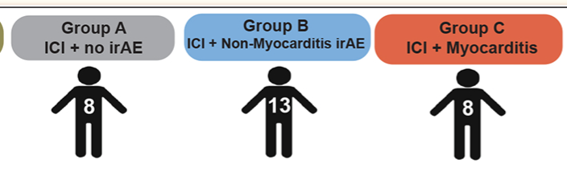
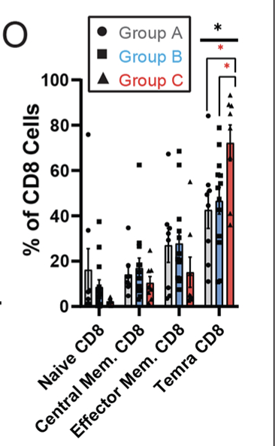
Myocarditis paper cell abundance conclusions
Temra CD8⁺ cells higher in myocarditis irAE group vs. non-myocarditis irAE and control (CyTOF data)

